Slide 1


Understanding Compose modifiers and how their order affects UI
Marcin Moskała
@marcinmoskala

Slide 2

Marcin Moskała
Consultant, contractor, trainer
JetBrains partner for teaching Kotlin
GDE in Android
Creator of Coroutines Mastery learning experience.
The author of:
Kotlin Coroutines: Deep Dive
Effective Kotlin: Best Practices
Functional Kotlin
Kotlin Essentials
Advanced Kotlin
Android development with Kotlin
Founder of Kt. Academy www.kt.academy

Slide 3
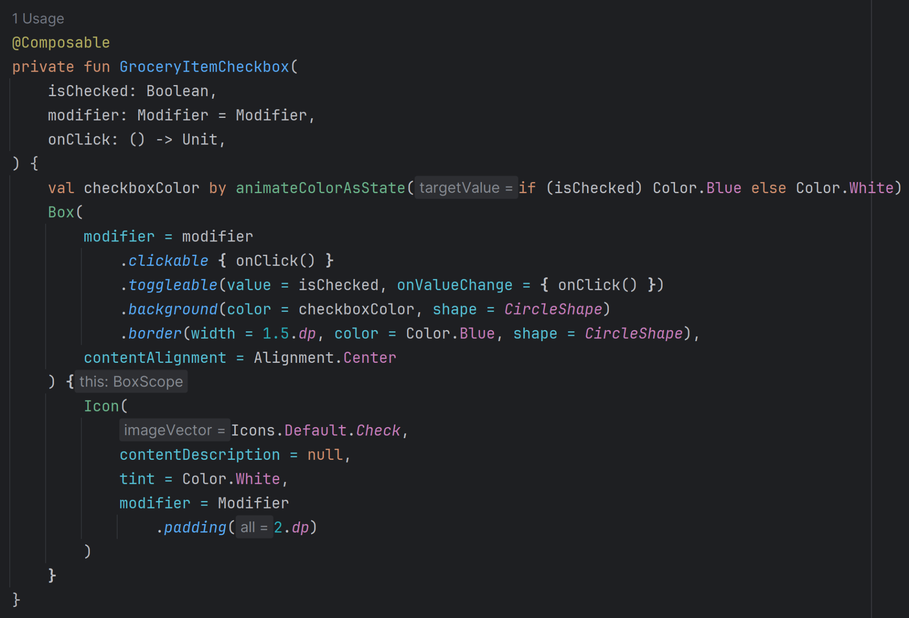
Notes:
The most important step is measuring and tracking our application.
The second one is testing and reproducing situations that we want to debug.
Only then we start debugging.
I will present those topic in order, because only then them truly make sense.

Slide 4
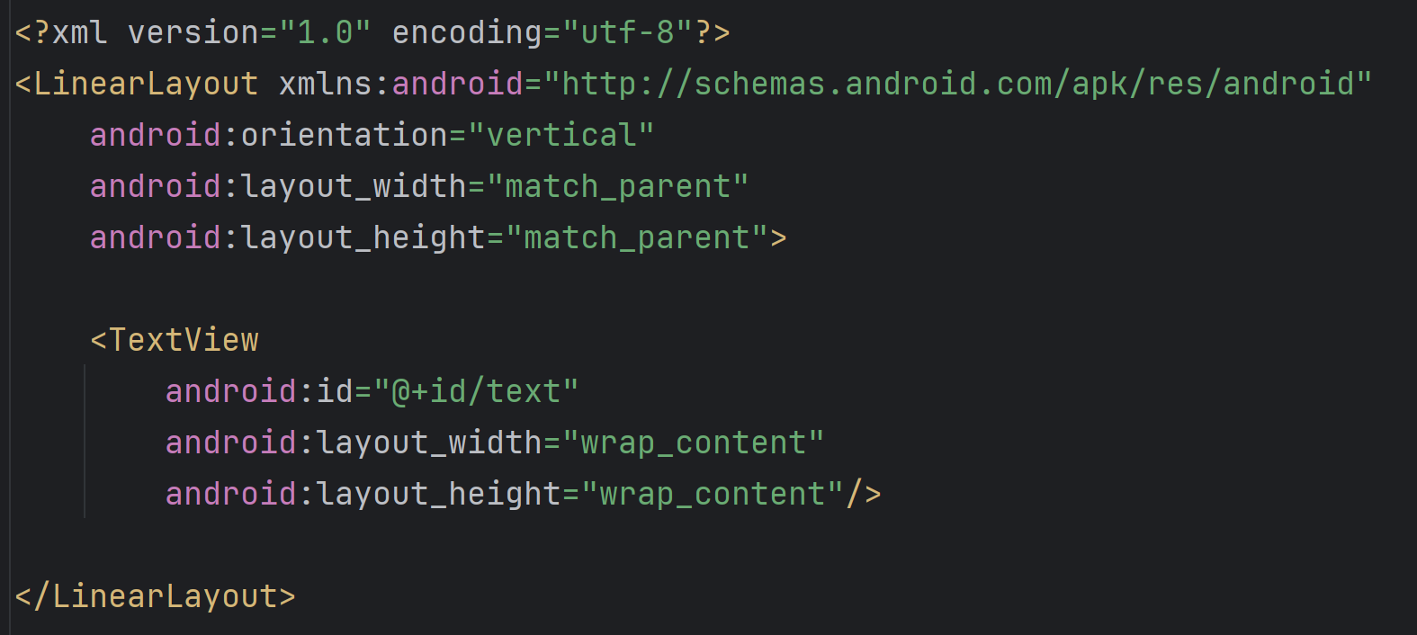
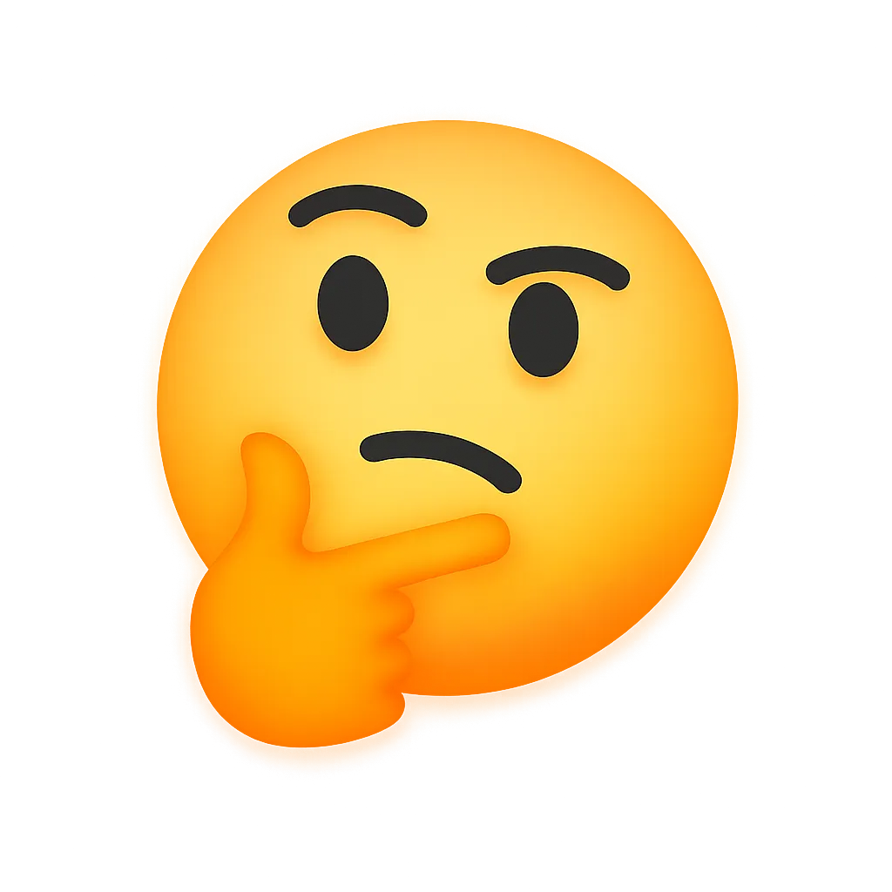

Why is this way of seeing modifiers wrong?
Makes devs assume that modifiers are implemented by components
Notes:
The most important step is measuring and tracking our application.
The second one is testing and reproducing situations that we want to debug.
Only then we start debugging.
I will present those topic in order, because only then them truly make sense.

Slide 5
clickable
@Composable
fun BasicText(
text: String,
modifier: Modifier = Modifier,
style: TextStyle = TextStyle.Default,
onTextLayout: ((TextLayoutResult) -> Unit)? = null,
overflow: TextOverflow = TextOverflow.Clip,
softWrap: Boolean = true,
maxLines: Int = Int.MAX_VALUE,
minLines: Int = 1,
color: ColorProducer? = null
) {
// …
Layout(finalModifier, EmptyMeasurePolicy)
}
graphicsLayer
drawBehind
onGloballyPositioned
semantics
pointerinput
Layout

Slide 6
Why is this way of seeing modifiers wrong?
Makes devs assume that modifiers are implemented by components
Makes it confusing how modifiers order affects UI
Notes:
I guess many of you came here to learn about special tools for debugging coroutines. I will cover them, but first I need to cover much more important topics. Debugging is a process, and starting a debugger is the last, rarely reached, step.
The most important step is measuring and tracking our application.
The second one is testing and reproducing situations that we want to debug.
Only then we start debugging.
I will present those topic in order, because only then them truly make sense.

Slide 7
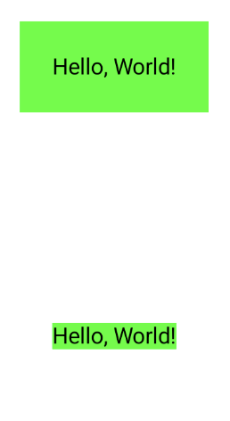

Text(
text = "Hello, World!",
modifier = Modifier
.background(Green)
.padding(20.dp)
)
Text(
text = "Hello, World!",
modifier = Modifier
.padding(20.dp)
.background(Green)
)
Text(
text = "Hello, World!",
modifier = Modifier
.clickable { }
.padding(20.dp)
)
Text(
text = "Hello, World!",
modifier = Modifier
.padding(20.dp)
.clickable { }
)

Slide 8
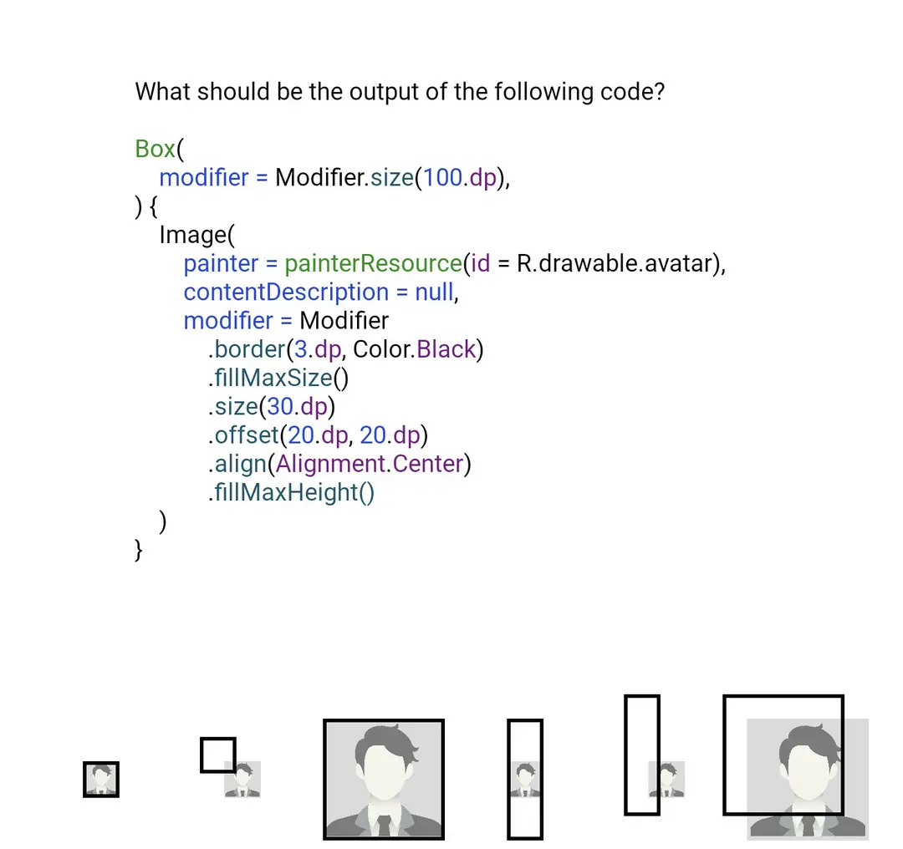

Slide 9

@Composable
fun Order(
Modifier: @Composable () -> Unit = { }
) {
Modifier {
Size(100.dp) {
Box {
Background(Color.Red) {
Padding(10.dp) {
Background(Color.Green) {
Padding(10.dp) {
Background(Blue) {
Padding(10.dp) {
Image(
painter = ...,
)
}
}
}
}
}
}
}
}
}
}
@Composable
fun Order(
modifier: Modifier = Modifier
) {
Box(
modifier = modifier
.size(100.dp)
) {
Image(painter = ...,
modifier = Modifier
.background(Color.Red)
.padding(10.dp)
.background(Color.Green)
.padding(10.dp)
.background(Blue)
.padding(10.dp)
)
}
}
Current design
Initial design

Slide 10
@Composable
fun UserItem(
user: User = User("Name", "imageUrl"),
onClick: () -> Unit = {}
) {
Row(
verticalAlignment = Alignment.CenterVertically,
modifier = Modifier.padding(10.dp)
.fillMaxWidth()
) {
Image(
painter = painterResource(id = R.drawable.avatar),
contentDescription = "Image",
modifier = Modifier.size(50.dp)
.clip(CircleShape)
)
Text(
text = user.name,
modifier = Modifier.padding(start = 10.dp)
.clickable { onClick() }
)
}
}
Padding
fillMaxWidth
Row
size
Padding
clip
clickable
Image
Text

Slide 11
Padding
Padding
fillMaxWidth
fillMaxWidth
Row
Row
size
Padding
size
Padding
clip
clickable
clip
clickable
Image
Text
Image
Text

Slide 12
@Preview(device = Devices.PIXEL_4_XL)
@Composable
fun Order(
modifier: Modifier = Modifier
) {
Box(
modifier = modifier.size(100.dp)
) {
Image(
painter = painterResource(id = R.drawable.avatar),
contentDescription = "Image",
modifier = Modifier
.background(Red)
.padding(10.dp)
.background(Green)
.padding(10.dp)
.background(Blue)
.padding(10.dp)
)
}
}

Slide 13
.layout { measurable, constraints ->
// Place to transform constraints
val placeable = measurable.measure(constraints)
// Place to transform size
layout(placeable.width, placeable.height) {
// Place to transform position
placeable.place(0, 0)
}
}
@Preview(device = Devices.PIXEL_4_XL)
@Composable
fun Order(
modifier: Modifier = Modifier
) {
Box(
modifier = modifier.size(100.dp)
) {
Image(
painter = painterResource(id = R.drawable.avatar),
contentDescription = "Image",
modifier = Modifier
.background(Red)
.padding(10.dp)
.background(Green)
.padding(10.dp)
.background(Blue)
.padding(10.dp)
)
}
}
.drawWithContent {
// Drawing before children
drawContent() // Drawing children
// Drawing after children
}
Constraints
Layout
Layout
Drawing

Slide 14
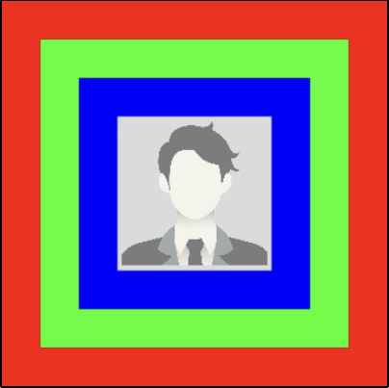
@Preview(device = Devices.PIXEL_4_XL)
@Composable
fun Order(
modifier: Modifier = Modifier
) {
Box(
modifier = modifier.size(100.dp)
) {
Image(
painter = painterResource(id = R.drawable.avatar),
contentDescription = "Image",
modifier = Modifier
.background(Red) Draw red on the current (Image) area
.padding(10.dp) Add padding (makes internal smaller)
.background(Green) Draw green on the current area
.padding(10.dp) Add padding (makes internal smaller)
.background(Blue) Draw blue on the current area
.padding(10.dp) Add padding (makes internal smaller)
)
}
}
See code

Slide 15
Box(
modifier = Modifier.size(100.dp)
) {
Image(
painter = painterResource(id = R.drawable.avatar),
contentDescription = "Image",
modifier = Modifier
.background(Red)
.padding(10.dp)
.background(Green)
.padding(10.dp)
.background(Blue)
.padding(10.dp)
)
}
W: 0-100, H: 0-100, x: 0, y: 0
W: 0-100, H: 0-100, x: 0, y: 0
W: 0-80, H: 0-80, x: 10, y: 10
W: 0-80, H: 0-80, x: 10, y: 10
W: 0-60, H: 0-60, x: 20, y: 20
W: 0-60, H: 0-60, x: 20, y: 20
W: 0-40, H: 0-40, x: 30, y: 30
W: 100, H: 100, x: 0, y: 0
W: 100, H: 100, x: 0, y: 0
W: 80, H: 80, x: 10, y: 10
W: 80, H: 80, x: 10, y: 10
W: 60, H: 60, x: 20, y: 20
W: 60, H: 60, x: 20, y: 20
W: 40, H: 40, x: 30, y: 30
Constraints
Calculated values

Slide 16
Box(
modifier = Modifier.fillMaxSize()
) {
Image(
painter = painterResource(id = R.drawable.avatar),
contentDescription = "Image",
modifier = Modifier
.background(Red)
.padding(10.dp)
.background(Green)
.padding(10.dp)
.background(Blue)
.padding(10.dp)
)
}
W: 0-Inf, H: 0-Inf, x: 0, y: 0
W: 0-Inf, H: 0-Inf, x: 0, y: 0
W: 0-Inf, H: 0-Inf, x: 10, y: 10
W: 0-Inf, H: 0-Inf, x: 10, y: 10
W: 0-Inf, H: 0-Inf, x: 20, y: 20
W: 0-Inf, H: 0-Inf, x: 20, y: 20
W: 0-Inf, H: 0-Inf, x: 30, y: 30
W: 180, H: 180, x: 0, y: 0
W: 180, H: 180, x: 0, y: 0
W: 160, H: 160, x: 10, y: 10
W: 140, H: 140, x: 10, y: 10
W: 120, H: 120, x: 20, y: 20
W: 120, H: 120, x: 20, y: 20
W: 100, H: 100, x: 30, y: 30
Constraints
Calculated values
See code

Slide 17
Box(
modifier = Modifier
) {
Image(
painter = painterResource(id = R.drawable.avatar),
contentDescription = "Image",
modifier = Modifier
.background(Red)
.padding(10.dp)
.background(Green)
.size(100.dp)
.padding(10.dp)
.background(Blue)
.padding(10.dp)
)
}
W: 0-Inf, H: 0-Inf, x: 0, y: 0
W: 0-Inf, H: 0-Inf, x: 0, y: 0
W: 0-Inf, H: 0-Inf, x: 10, y: 10
W: 100, H: 100, x: 10, y: 10
W: 80, H: 80, x: 20, y: 20
W: 80, H: 80, x: 20, y: 20
W: 60, H: 60, x: 30, y: 30
W: 100, H: 100, x: 0, y: 0
W: 100, H: 100, x: 0, y: 0
W: 80, H: 80, x: 10, y: 10
W: 80, H: 80, x: 10, y: 10
W: 60, H: 60, x: 20, y: 20
W: 60, H: 60, x: 20, y: 20
W: 40, H: 40, x: 30, y: 30
Constraints
Calculated values
See code

Slide 18

Box(
modifier = Modifier.size(100.dp)
) {
Image(
painter = painterResource(
id = R.drawable.avatar
),
contentDescription = "Image",
modifier = Modifier
.background(Red)
.clip(CircleShape)
.border(2.dp, Green)
.offset(10.dp, 10.dp)
.padding(10.dp)
)
}
See code

Slide 19

Notes:
https://marcinmoskala.com/ModifierOrderGuesser/

Slide 20
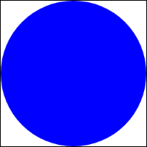
private class CircleNode(var color: Color) : DrawModifierNode, Modifier.Node() {
override fun ContentDrawScope.draw() {
drawCircle(color)
}
}
private data class CircleElement(val color: Color) : ModifierNodeElement<CircleNode>() {
override fun create() = CircleNode(color)
override fun update(node: CircleNode) {
node.color = color
}
}
fun Modifier.circleBackground(color: Color) = this then CircleElement(color)
@Preview
@Composable
fun CirclePreview() {
Box(
modifier = Modifier
.size(100.dp)
.circleBackground(Color.Blue)
)
}

Slide 21
Node types
01.
02.
03.
LayoutModifierNode - changes how it's wrapped content is measured and laid out.
DrawModifierNode - draws into the space of the layout.
SemanticsModifierNode - adds semantics key/value for use in testing, accessibility, and similar use cases.
04.
05.
PointerInputModifierNode - receives PointerInputChanges.
LayoutAwareModifierNode - receives onMeasured and onPlaced callbacks.
Examleps

Slide 22


Slide 23
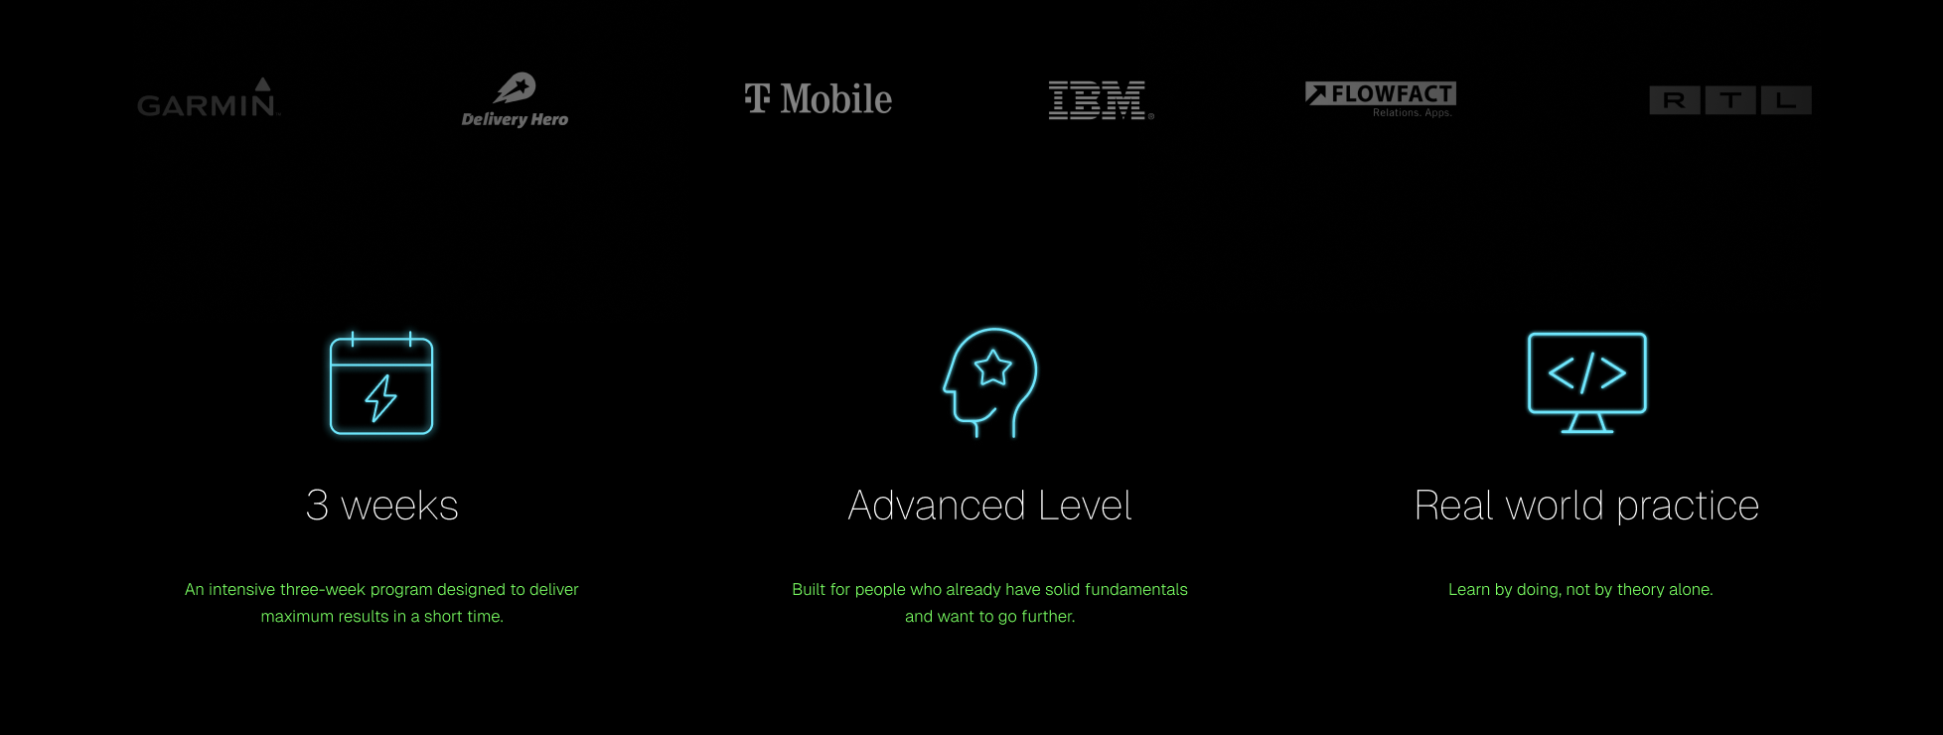

Slide 24
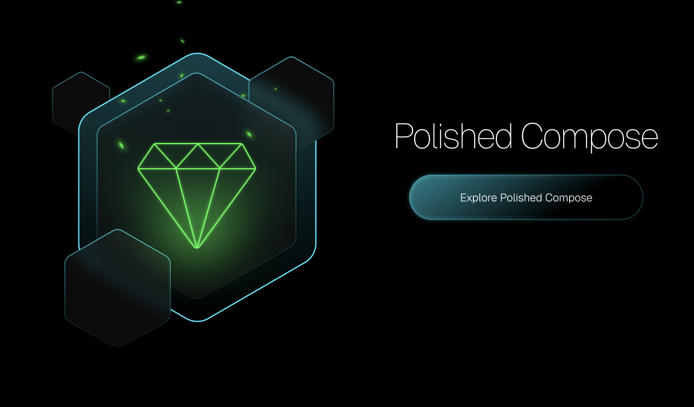

Slide 25


Slide 26
Understanding Compose modifiers and how their order affects UI
Marcin Moskała
@marcinmoskala

